Slide 1

INTRODUCTION
Meaning of Online Attendance :—
“ Online Attendance Management System is an application developed for student’s daily attendance in school. It helps to maintain the accurate record and generate summarized student attendance reports for the students ”

Slide 2
online Attendance System

Slide 3
ABOUT THIS TOPIC
our topic is depends on QR code and scanner to attend the daily record of people to their work in and out a record
Our topic based on python language and it has and python libraries/modules and we use the pyqrcode, OpenCV, NumPy, libraries, and many more we use the project a get an inti ID card, security access card, and use too many companies also

Slide 4
Widely Used As:-
To overcome the manual attendance issues, we proposed and implemented a smart attendance system using Python Programmed with the aim to encourage the potential use of the Quick Response (QR) code as a future attendance management system, to track and record student attendance in lectures and exercises for all relevant courses.........
Future Scope :-
With the help of Smart Attendance QR Code System, In future we have no need of QR code Scanner machine, Its simply done by python programming .….....

Slide 5
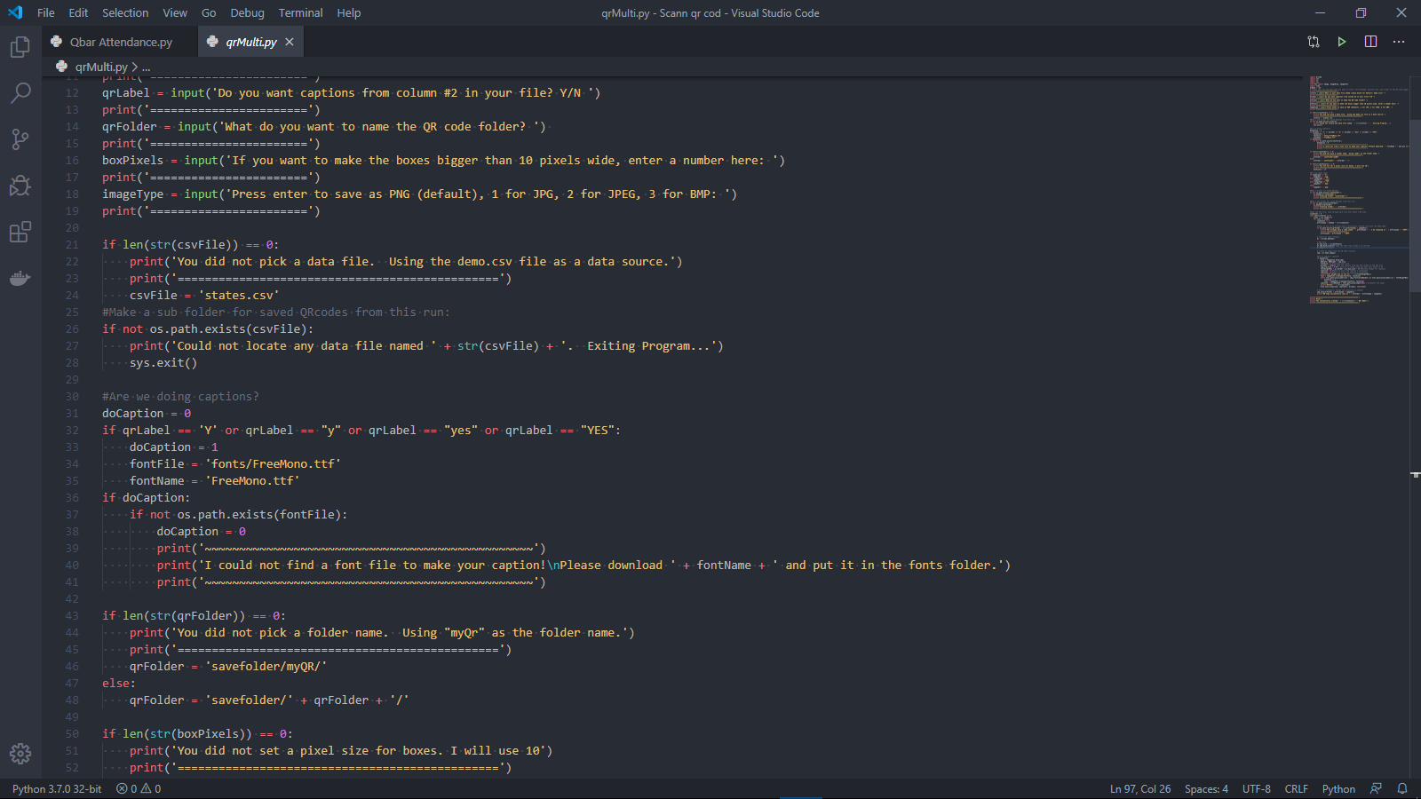
Advantages :-
With the help of these system we don’t require any manual work (i.e. that is we don’t require paper pen to record Attendance….
This System is fast and works faster than any other Manual systems….. The System can be also used in various Official work sectors , to record an attendance of an Employee….
In this System , there is no need of Face recognition , fingerprint reader ,etc. It is Easily operated by both Host and user(Attending person)…..

Slide 6
Conclusion From This QR code System :-
“ QR Code Attendance System is simple and convenient to use, no external devices like Biometric Scanners are required. ... Nowadays the use of smartphones can make everyone's life simple and easy. ”

Slide 7



USED TOOLS IN PROJECT
languages
Python libraries
We Have Used
Python
programming language
We Have Used some standard Python libraries
IDE
We Have Used
Vvisual studio Software or u can also use Pycharm Software

Slide 8
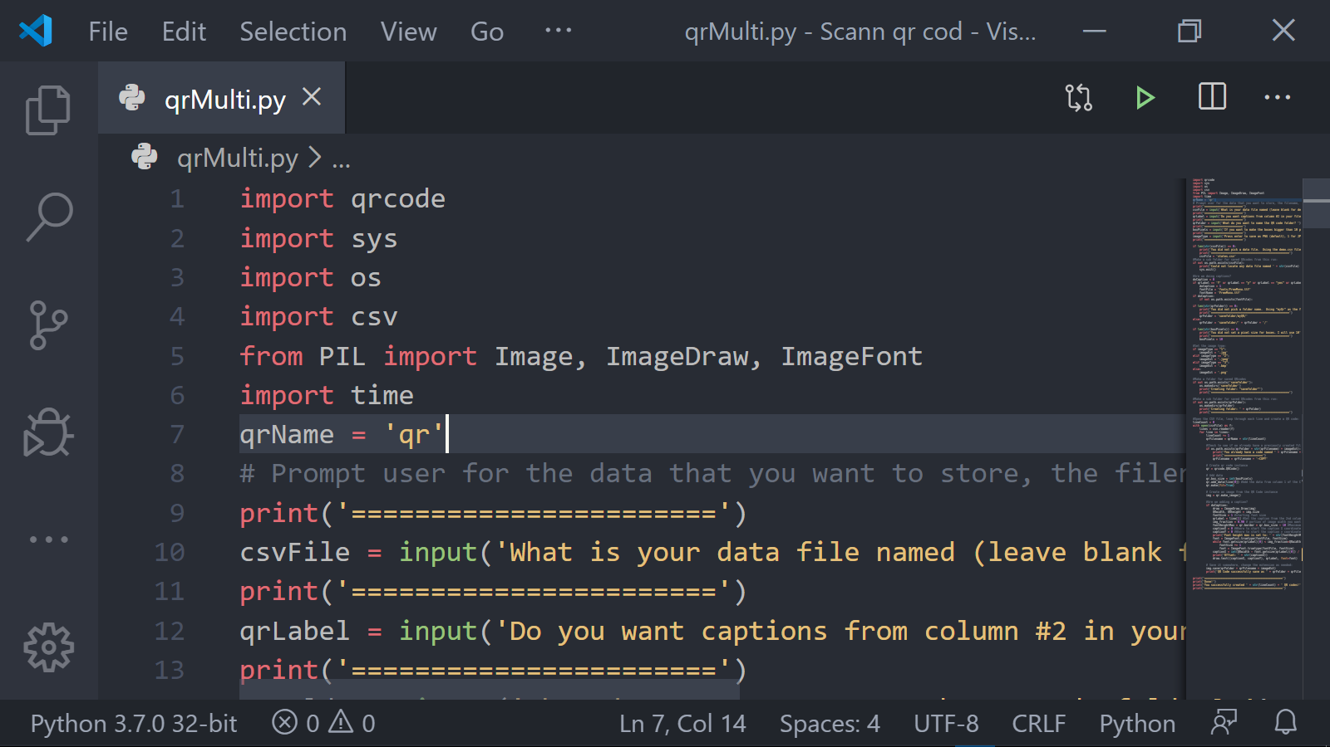
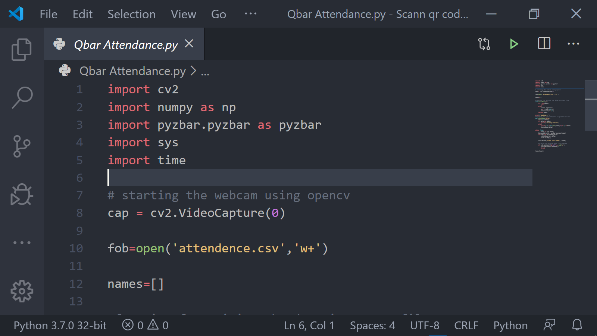
USED PYTHON LIBRARIES
For QR Code :-
For QR Code Scanner :-
import cv2
import numpy
import pyzbar
import sys
import time
import qrcode
import sys
import os
import csv
import time

Slide 9
DOCUMENTATION FOR QR CODE'S
qrcod/Pyqrcode :-
This module is used to create QR Codes. It is designed to be as simple and as possible. It does this by using sane defaults and auto detection to make creating a QR Code very simple.
It is recommended that you use the pyqrcode.create() function to build the QRCode object. This results in cleaner looking code.
You can get all python libraries documentation/Examples at https://docs.python.org/3/library/

Slide 10
DOCUMENTATION FOR QR Code SCANNER
CV2/OpenCV:-
OpenCV is a huge open-source library for computer vision, machine learning, and image processing. OpenCV supports a wide variety of programming languages like Python, C++, Java, etc. It can process images and videos to identify objects, faces, or even the handwriting of a human

Slide 11
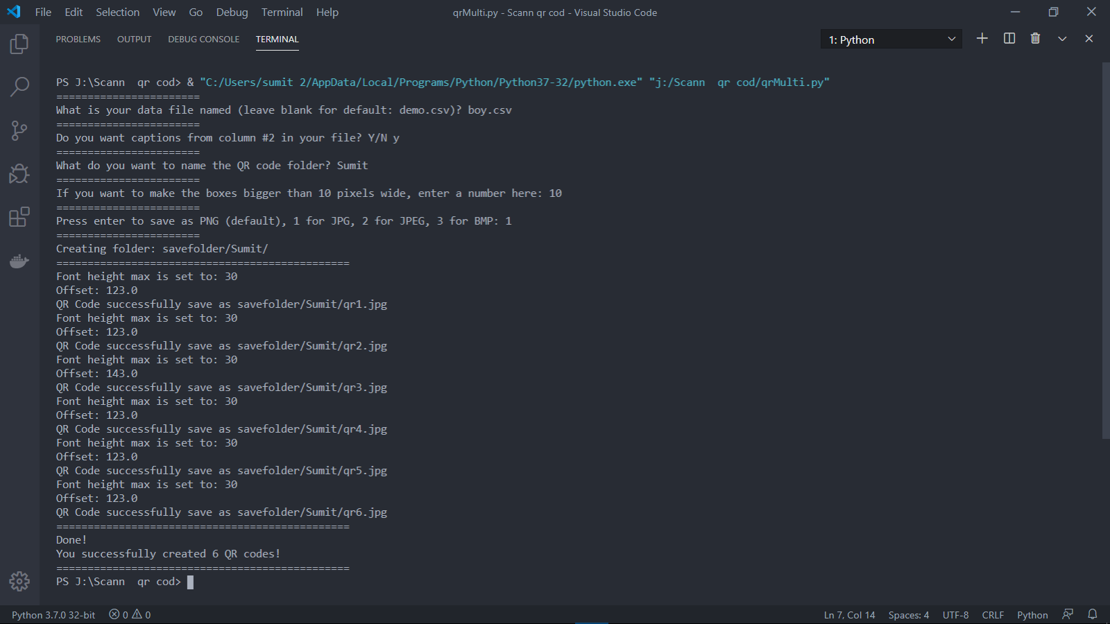
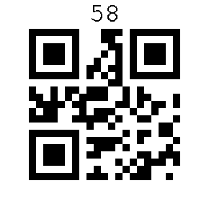
Step 1
PROCESS
Create an Excel file and make it an
.CSV Format
Step 2
Then add this file in program
Step 3
Then Run the program and the program asks you Questions
like:-
1. what is the name of your CSV file
2. can you add a second Colum in your fill this option you can add a caption to QR code IMG
3. what is the size of QR code IMG 1 to 10 pixels
4. what is a format of QR code IMG JPG, JPEG, BMP

Slide 12
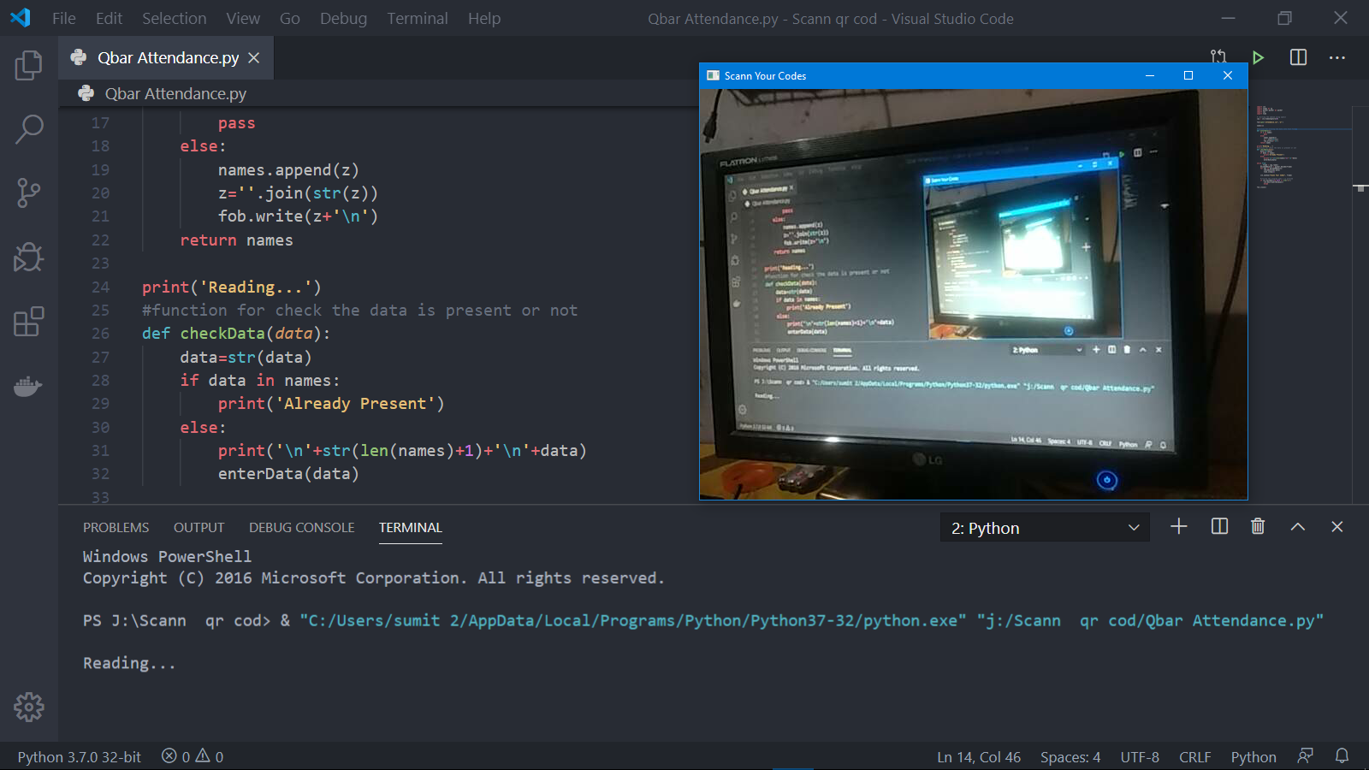
Step 4
Run the QR Scanner program then your PC Webcam is open
Step 5
Then you show the QR code IMG to your Webcam , It will automatically scan the QR Codes
and the program shows the name of Students

Slide 13
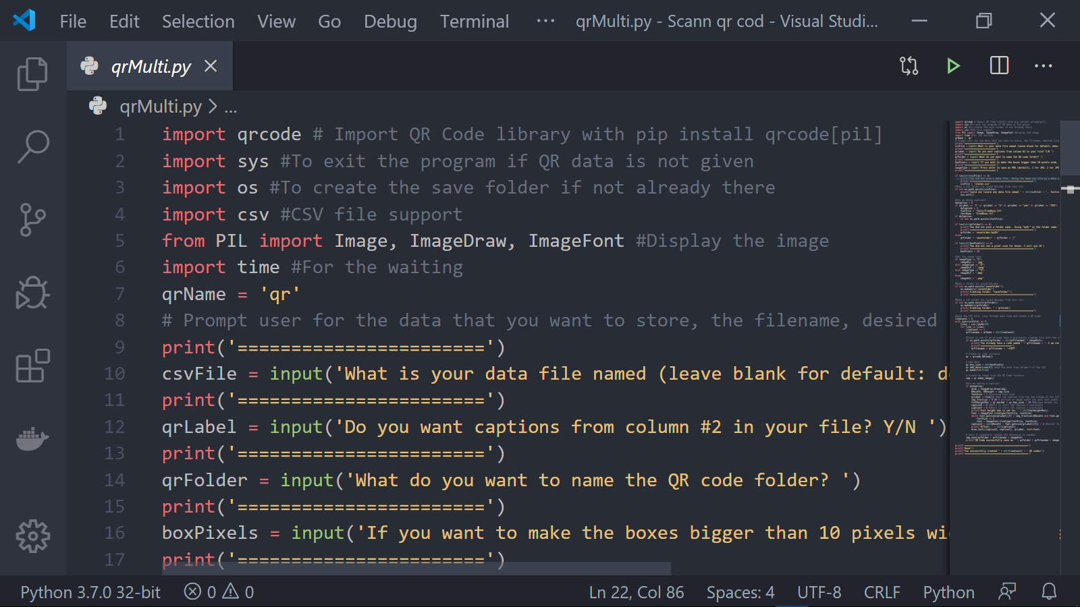
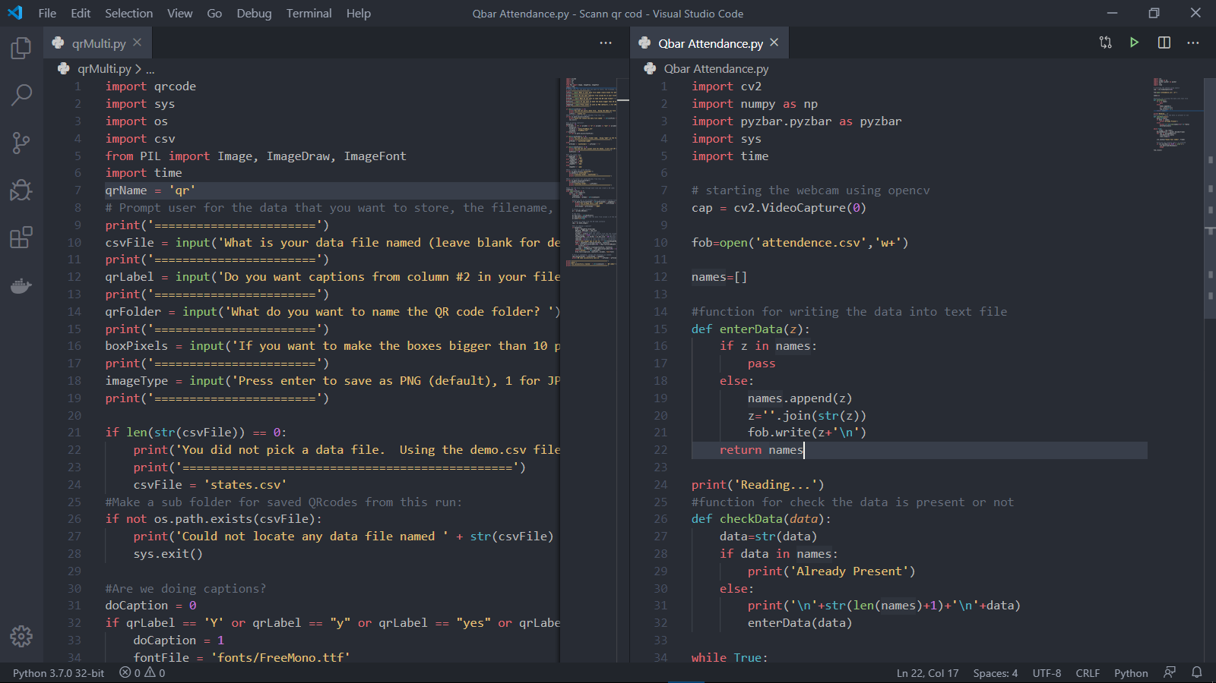
PROGRAMME IMAGES

Slide 14
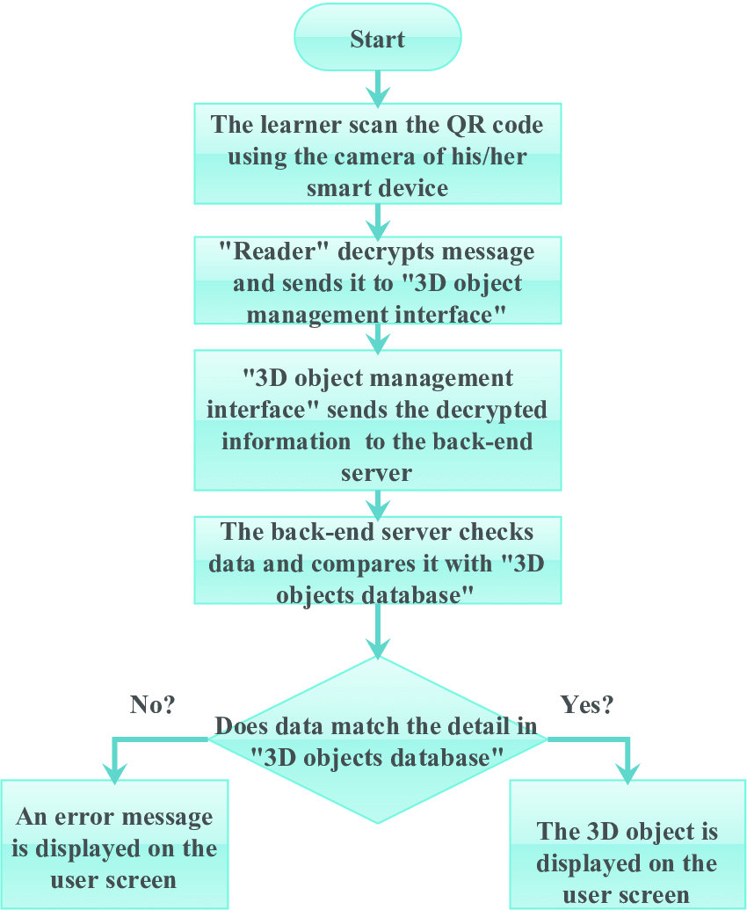
Flowchart of the process of Scan a QR code

Slide 15
Disadvantages :
The Host must be be careful, where the Attendants should not gave everyone Attendance with more QR codes The QR code is must be secured so at a time One person give only one attendance…
In the system , the camera used as scanner is must of good quality…bad Quality camera can affect the attendance of each and every person or attendant

Slide 16
RESOURCES
We have used Stack overflow for fixing the bugs in our programme / Project. ( www.Stackoverflow.com )
We have also used GitHub for further project information. ( www github.com )
Also the main website Python.org Is also used for installing libraries/modules….. ( www.python.org )

Slide 17
Thank you

